Slide 1
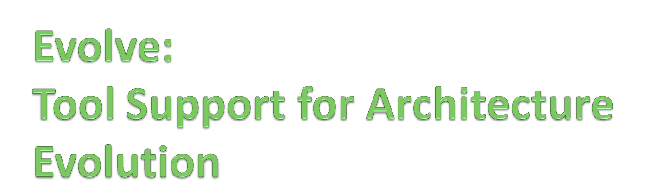
...or...
“evolution as intrinsic to
architecture definition”
Andrew McVeigh
Jeff Magee
Jeff Kramer
Imperial College, London

Slide 2

Motivating extension scenario...
Developer X
Developer Y
Developers of base system
Notes:
Base versus extensions
Combining extensions
Parties behind software... Mention radio station

Slide 3
Extensibility Requirements...
  ALTER
  Must allow any possible extension even if unplanned
  NO_IMPACT
  Others should not be impacted by extensions they don’t want
  COMBINE
  Extensions / upgrades can be combined, problems rectified
  DECENTRALIZED
  Support a fully decentralized environment with many parties
  NO_SOURCE
  Must work even without source code!
Notes:
Show slide on other projector of decentralized team environment.
ALTER – commensurate pushed us in the direction of hierarchical components which support multiple levels of abstraction.
NO_IMPACT means we can’t directly amend the base architecture for a new requirement.
These requirements basically pushed us directly into providing full evolution support from an architectural perspective, with many characteristics of a distributed CM system like Mercurial.
Decentralized: no common CM system, lots of ways of distributing system.

Slide 4
The Evolve Approach
Add 3 concepts to a Darwin/ROOM-like ADL
A
B
1. Resemblance:
Reuse via deltas
B
A
A’
2. Replacement:
Global substitution
2. Evolution:
Delta adjustment
3. Stratum:
Groups definitions
base
extension
Notes:
Talk through original motivation for work

Slide 5
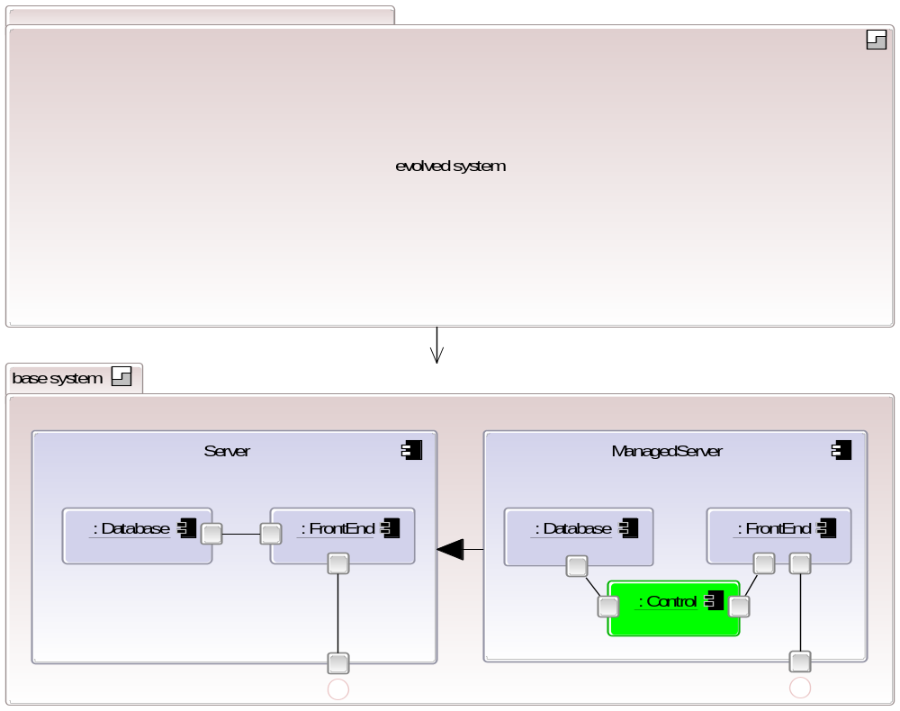
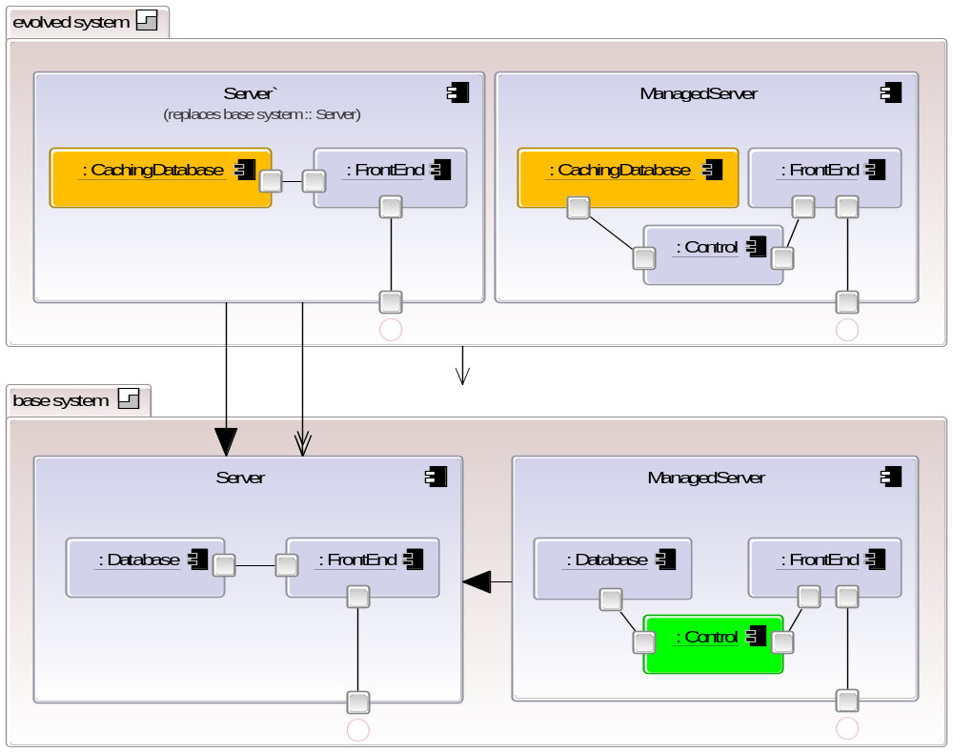
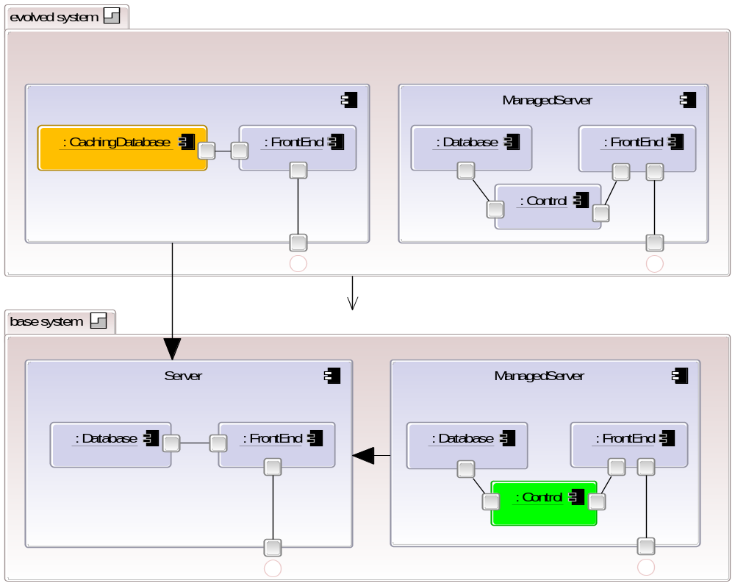
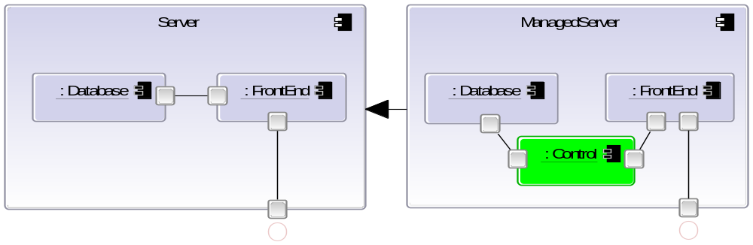
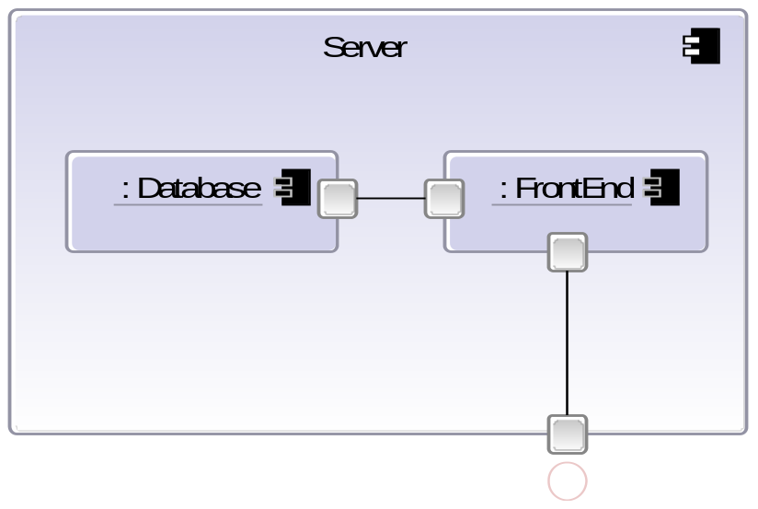
Notes:
NOTE: keep deltas separate from base! Apply to get extended system, leave to keep base.
We could carry on doing this – adding deltas on top of deltas
Mention that base is really just add deltas.
Want to have an intuitive way of designing... We will now introduce 3 concepts that unify reuse and extension.

Slide 6
The Expanded Resemblance Graph
Base perspective
Extension perspective
Managed
Server
Managed
Server
Server’
Server
Server

Slide 7
Demonstration

Slide 8
The Outcome
  Added support for evolution into core component language
    As opposed to adding ADL concepts to a CM system
    Starting from first principles creates a minimal distributed CM system deeply based on architectural concepts
Mapping onto CM & design concepts
  Resemblance → structural inheritance
  Evolution → delta change to existing components
Stratum combines module and changeset
  Unit of ownership and distribution
  Multiple strata with same parent → branches
  Stratum with 2 parents → merge + automated conflict detection
Notes:
Note that it is interesting: our requirements have caused us to recreate the concepts of a distributed CM system like mercurial in the design space!
Mention about wider applicability: applying concepts to model definitions at bank.

Slide 9
Summary
Evolution is intrinsic to the ADL
  Allows us to integrate evolution and design concepts
  Supports evolution with no central design authority
  Complementary with existing CM systems
  Implementation mappings subject to evolution also
  Supports import of existing Java components / beans
Allows a more agile approach to architecture
  Variance / extension points not needed in advance
  Design for current requirements
http://www.intrinsarc.com
Notes:
- version control can be treated orthogonally (2 axes): time based evolution and system variation: pragmatic

